Slide 1



Khushi Patel, Namita Shah
Mentored by Dr. Siddharth Srivastava
2023 Arizona Space Grant Symposium
April 22nd, 2023
AI-Enhanced Education:
Generalized Planning and Reinforcement Learning in Space Exploration

Slide 2
Project Overview
Research Question: In what way can we effectively convey high-level concepts of Artificial Intelligence (AI) to others in a digestible manner?
Objective:
By incorporating UI/UX design enhancements, this research aims to improve the comprehensibility and effectiveness of the educational platform JEDAI for its users.

Slide 3



Background
What is AI?
Why is AI useful?
How can AI be simplified?

Slide 4
Defining Terms
AI
The development of computer systems that can simulate human intelligence and behavior
Task and Motion Planning
Combines high-level task planning with low-level motion planning to enable robots and other autonomous agents to perform complex tasks in the physical world
Explainability in AI
Refers to the ability of AI systems to provide clear and understandable explanations for their decisions and actions

Slide 5
Defining Terms cont.
Reinforcement Learning
An AI approach where an agent learns to make decisions by interacting with its environment and receiving feedback in the form of rewards or punishments
Generalized Planning
An AI approach that aims to develop planning algorithms that can generate plans that are valid for multiple related problem instances, rather than a specific one

Slide 6




Why is AI Useful?
AI thinks, reasons, and learns similarly to the way humans do
Automate repetitive or time-consuming tasks
Process and analyze large amounts of data quickly and accurately
Improve efficiency and productivity in various industries

Slide 7
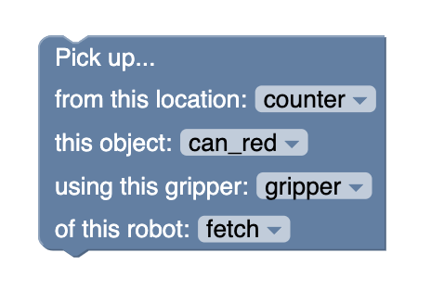
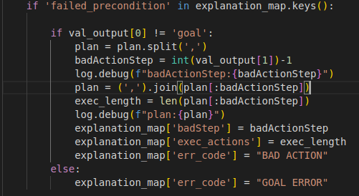
How can AI be simplified for beginners?
Abstraction to simplify complex information
  Prioritize fundamentals
Focus on process to perform actions
  Teach users high-level task planning
Use natural language instead of confusing technical language

Slide 8
Introducing JEDAI
I
A
D
E
J

Slide 9

Introducing JEDAI
JEDAI Explains Decision-Making AI
I
J
E
D
A

Slide 10
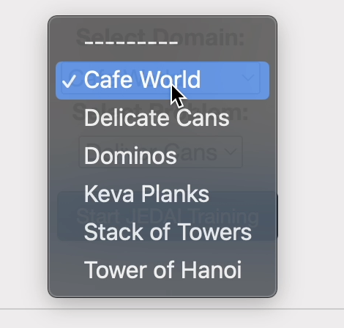
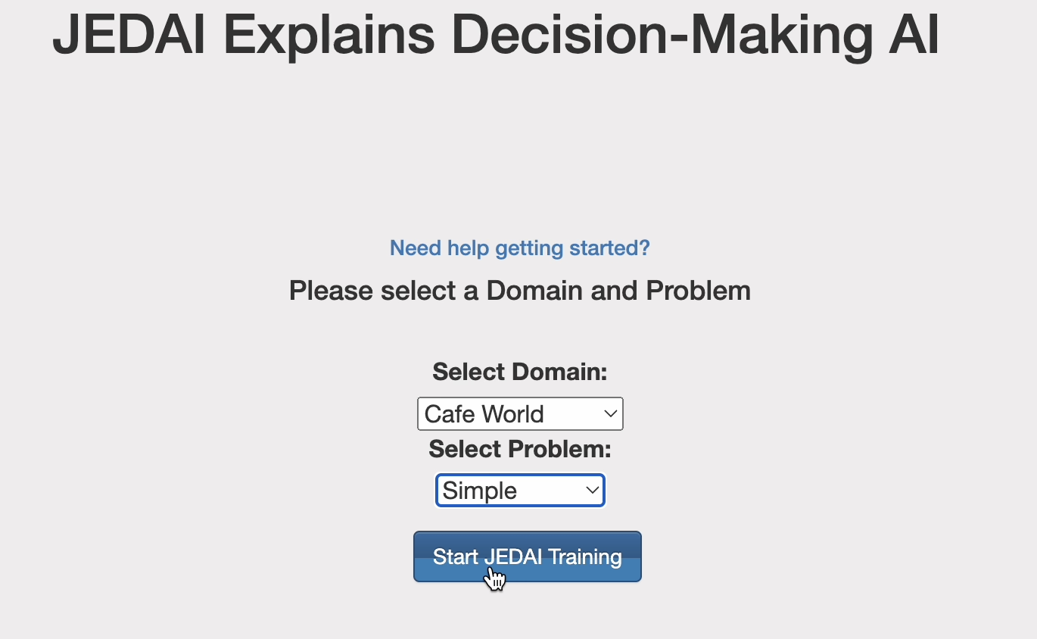
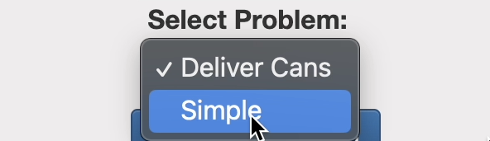
What is JEDAI?
Helps users learn the fundamentals of AI through easy-to-understand instructions and actions to be performed.
How does JEDAI work:

Slide 11
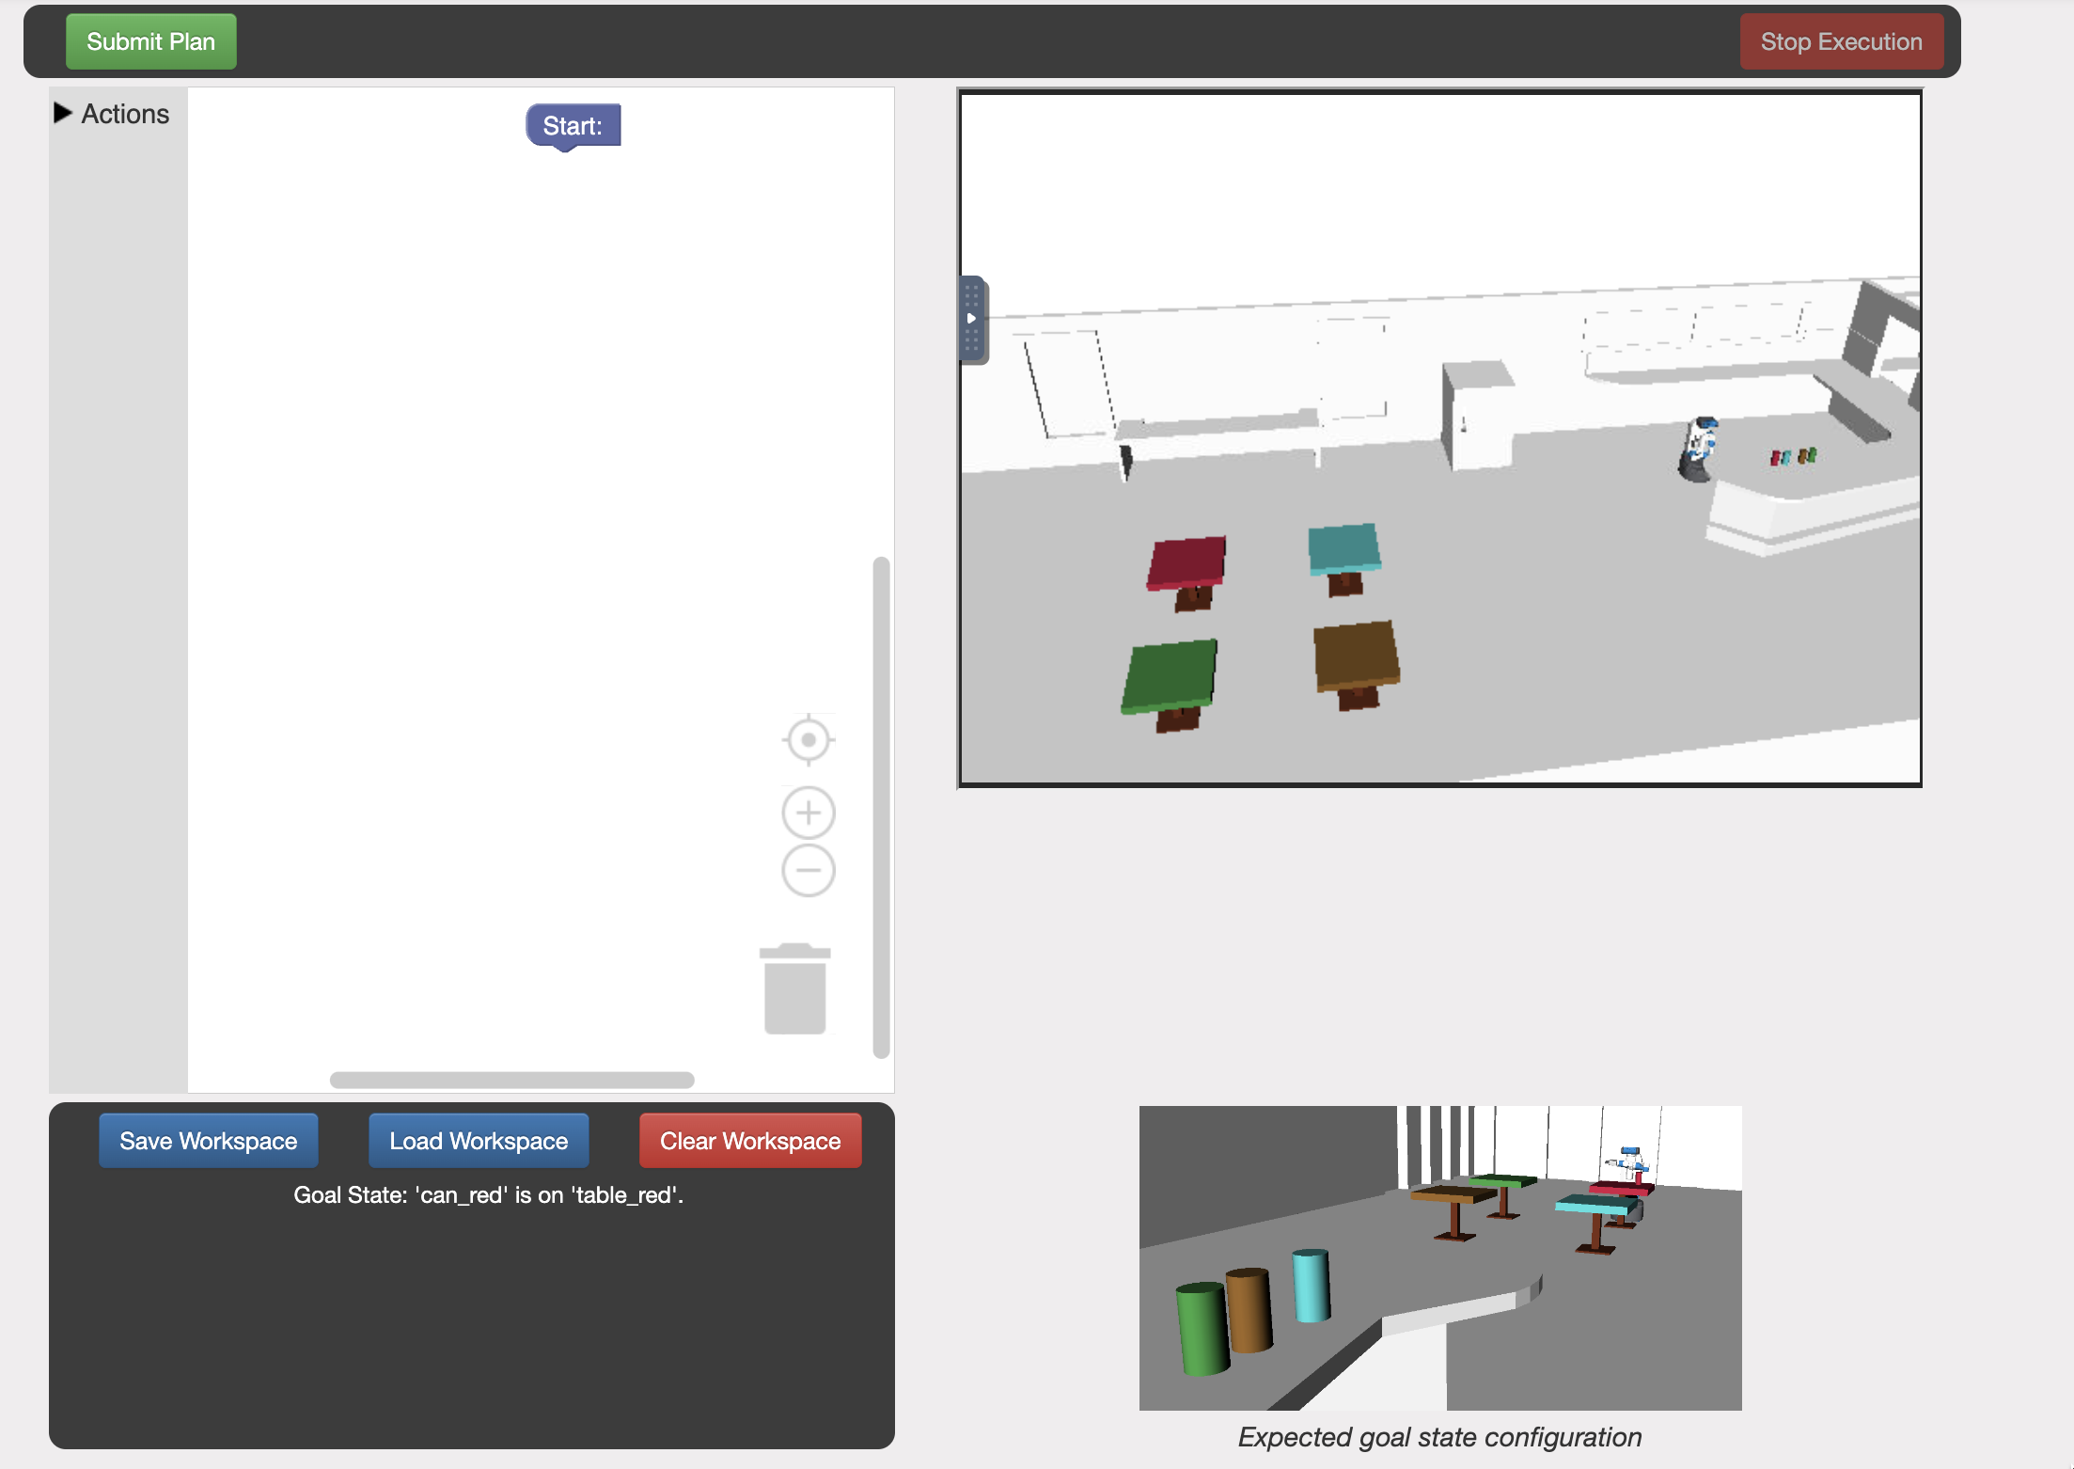
Training Area

Slide 12
3D simulation of robot and environment
Shows actions in real time
Users can navigate through environment

Slide 13
Displays goal state: the final, desired result of what actions the user should have the robot perform

Slide 14
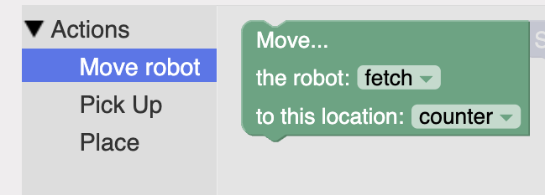
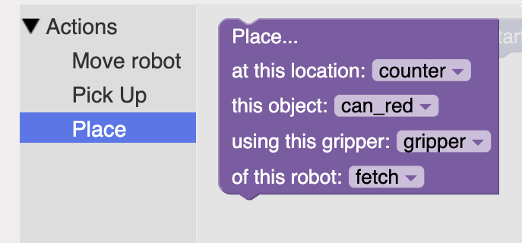
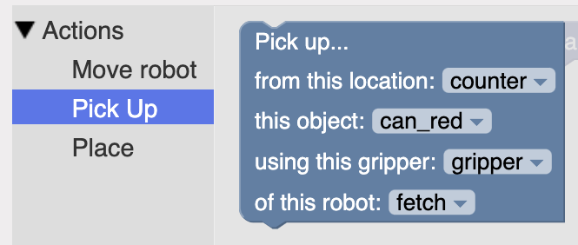
Drag-and-drop area
Users have access to block code to solve the problem

Slide 15
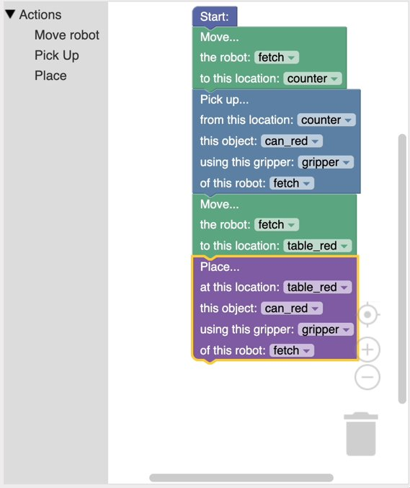

Slide 16
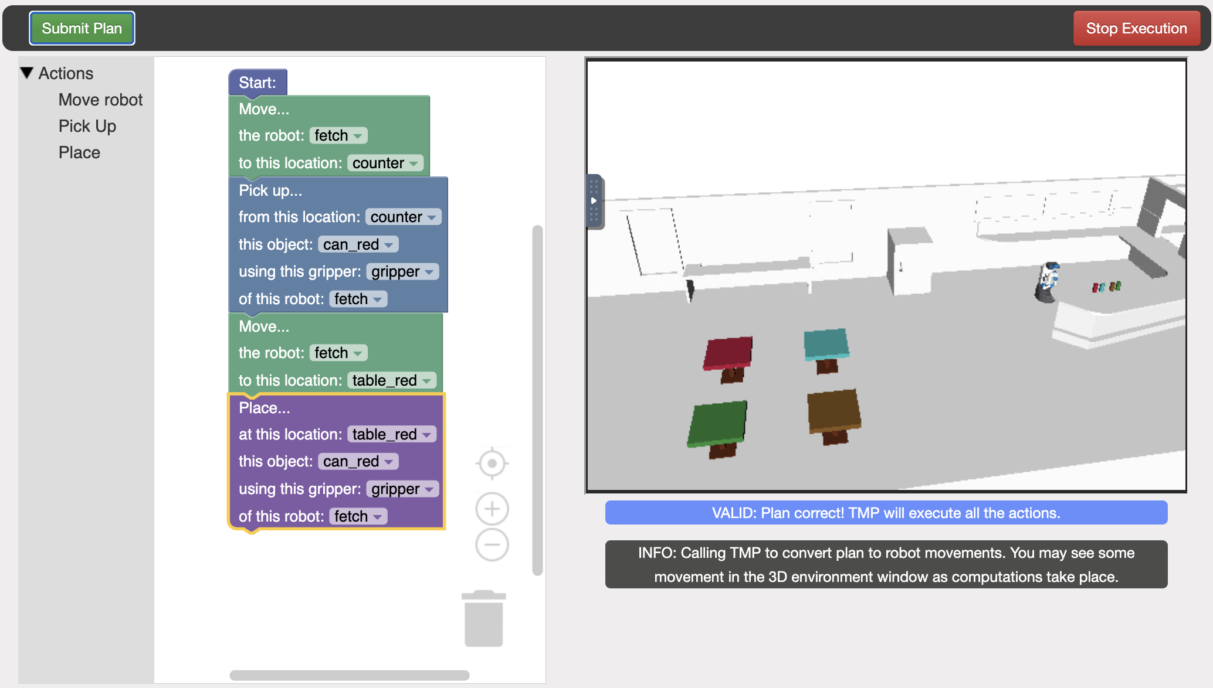
Scenario 1: User had a correct plan

Slide 17
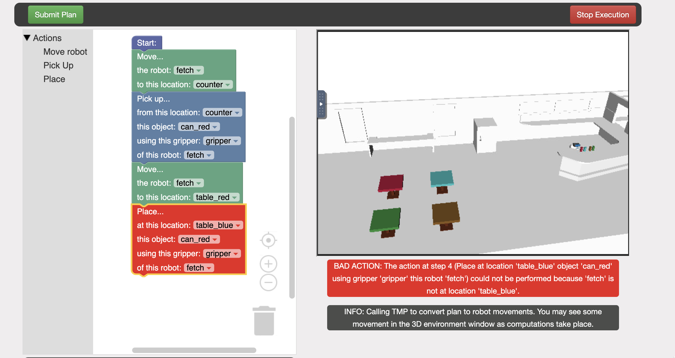
Scenario 2: User had an incorrect plan

Slide 18
Process
Improvements to the user interface
Better user experience
Program testing
Finding bugs and areas of improvement within program
Outreach methods
Demo Day: event for students to get hands-on experience with JEDAI and familiarize them with AI concepts

Slide 19
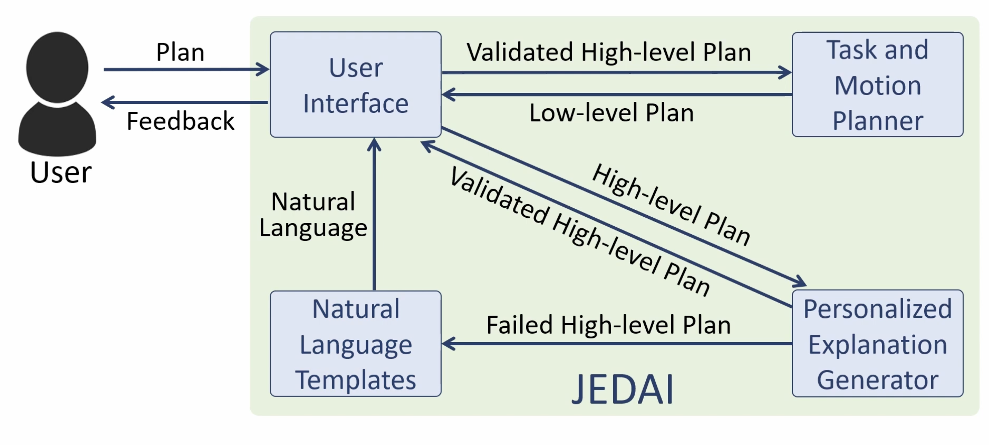
Results and Significance
[1]Diagram flow illustrating the interactions between user and JEDAI interface.

Slide 20


Future Work
Integrating features such as personalized learning paths, time clock, and gamification elements to increase user engagement and motivation
Creating different environments to better enhance learning experience

Slide 21

Acknowledgements
Dr. Siddharth Srivastava
Special Thanks to Rashmeet Nayyar, Jayesh Nagpal, Pulkit Verma, and Naman Shah
AAIR Lab
ASU/NASA Space Grant
Arizona Space Grant Consortium
This material is based upon work supported in part by the National Science Foundation under Grant 3037130. The material contained in this document is based upon work supported by a National Aeronautics and Space Administration (NASA) grant or cooperative agreement. Any opinions, findings, conclusions or recommendations expressed in this material are those of the author and do not necessarily reflect the views of NASA. This work was supported through a NASA grant awarded to the Arizona/NASA Space Grant Consortium.

Slide 22
References
[1] Research. AAIR Lab. (2021) Jedai Explains Decision-Making Ai. Retrieved April 7, 2023 from https://aair-lab.github.io/

Slide 23
Thank You!

